Slide 1
Sports and statistics Lecture 2: Statistics in baseball – and an overview about what makes a metric

Slide 2
Goals
What to look for?
Create a metric -- Runs created
Tools
Bivariate tools: scatter plots, r, R-squared

Slide 3
Questions we’ll want to answer
1 – Is the metric important to success?
2 – How well does the metric measure a player’s contribution?
3 – Is the metric repeatable?

Slide 4
Is the metric important to success? What’s “important?” What’s “success?” -Examples in baseball Stolen bases Batting average Home runs Walks RBIs Slugging percentage

Slide 5
How well does the metric measure a player’s contribution? Stolen bases Batting average Home runs Walks RBIs Slugging percentage Which are impacted by a player’s teammates? Which are impacted by a player’s ballpark? Which are impacted by a player’s coach? Which are impacted by a player’s era?

Slide 6
Is the metric repeatable? Stolen bases Batting average Home runs Walks RBIs Slugging percentage Why is repeatability (?) important? How does sample size fit in? How to judge repeatable?

Slide 7
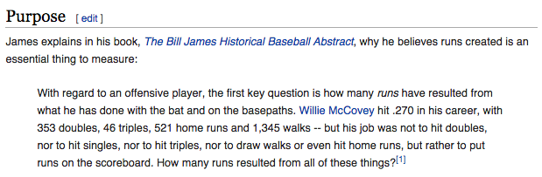
Ex: Runs created
Why runs created?

Slide 8
Ex: Runs created
General assumptions & expectations
Different valuations to different types of hits
Hitters only control their performance
Hitters do not control when they hit
Hitters do not control importance of at-bat relative to game’s outcome

Slide 9
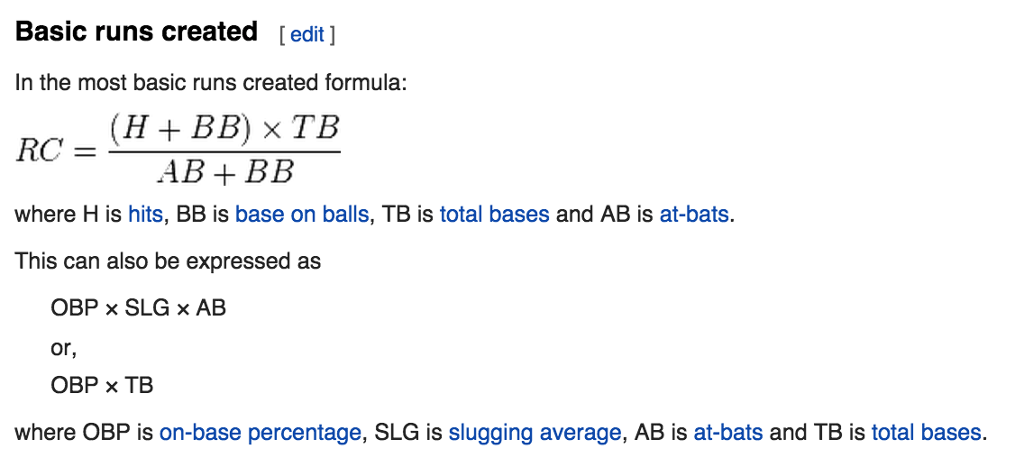
Ex: Runs created

Slide 10
Ex: Runs created
Benefits of runs created
Team level accuracy:
- Basic version can predict a team’s run total with correlation ~ 0.95
Individual talent:
- Reflects individual performance only
Repeatability?
- To be determined in lab

Slide 11
Ex: Runs created
Weaknesses of runs created

Slide 12
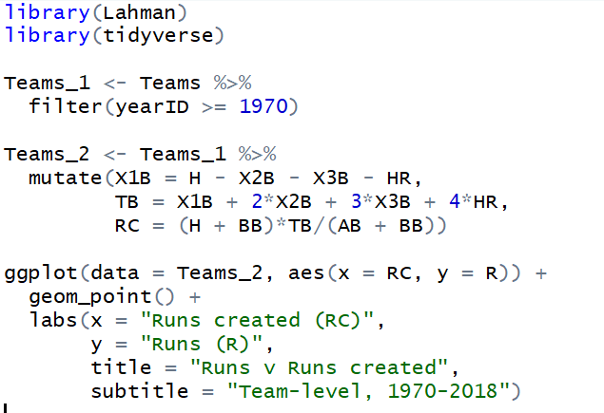
Ex: Runs created
What’s it look like?

Slide 13
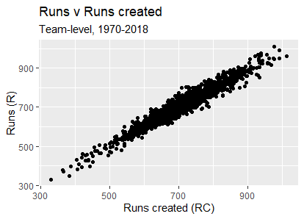
Ex: Runs created
What’s it look like?

Slide 14
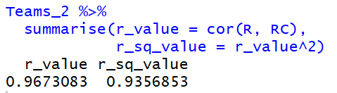
Ex: Runs created
How do we describe the association between runs created and actual runs?

Slide 15
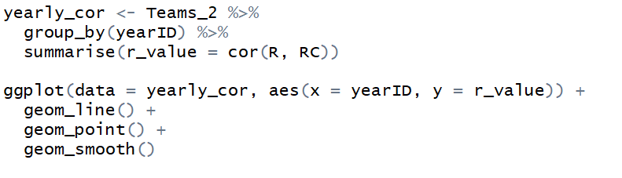
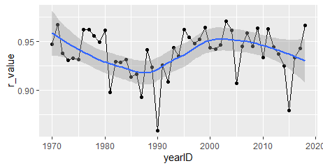
Ex: Runs created
How do we describe the association between runs created and actual runs? Has it changed over time?

Slide 16
Ex: Live coding
How to compare the correlation of several metrics at once?
How to code a correlation matrix
Use of the package `corrplot`
Create new variables to compare to RC

Slide 17
What we’ve shown
1 – Is runs created important to success?
2 – How well does the metric measure a player’s contribution?
3 – Is the metric repeatable?

Slide 18
Ex: Runs created
3 – Is the metric repeatable?
Explanatory power vs. Predictive power

Slide 19
Ex: Runs created
3 – Measuring repeatability
Before and after
Year t versus Year t + 1
Odd versus even

Slide 20
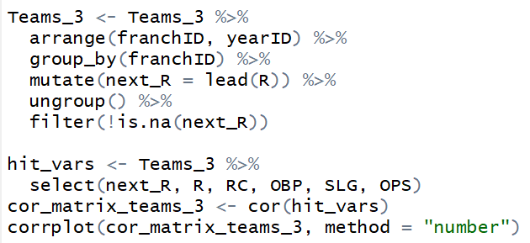
Ex: Runs created
3 – Year over Year comparisons

Slide 21
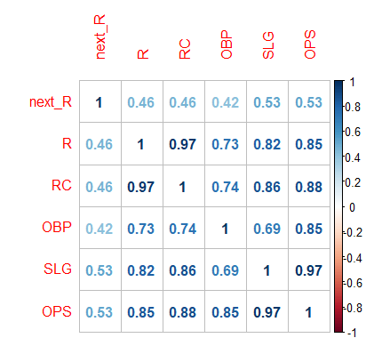
Ex: Runs created
3 – Is the metric repeatable?

Slide 22
Tools for assessing prediction error
Correlation with future performance:
Mean squared error:
Mean absolute error:

